Slide 1
Classification Metrics
Courtesy to
Tanvir Ahammad
Lecturer,
Dept. of CSE, JnU
E-mail: tanvir@cse.jnu.ac.bd

Slide 2
Contents
What is performance of classification?
What is confusion matrix?
What are the metrics used in classification?
How to measure the performance of classifiers?

Slide 3
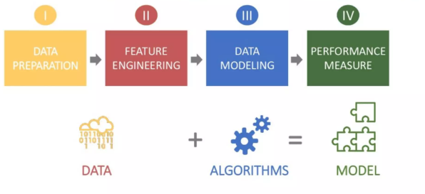
What is classification performance?
Steps in machine learning model:
The performance of classifiers is a measure of how well a machine learning model is able to accurately classify new or unseen data.

Slide 4
Confusion matrix
A confusion matrix is a table that is used to evaluate the performance of a classification model.
It is a matrix that shows the number of actual and predicted classifications for each class in the classification problem.
It is a common tool used in machine learning to evaluate the accuracy and performance of a classification model.
Each cell in the matrix represents the number of instances that were classified in a particular way.
Accuracy, precision, recall, F1-score

Slide 5
Confusion matrix (cont’d )
True positive (TP) value represents the number of instances that were correctly classified as positive
The case where a person is actually having cancer(1) and the model classifying his case as cancer(1) comes under True positive.
False positive (FP) value represents the number of instances that were incorrectly classified as positive
A person NOT having cancer and the model classifying his case as cancer comes under False Positives.
False negative (FN) value represents the number of instances that were incorrectly classified as negative
A person having cancer and the model classifying his case as No-cancer comes under False Negatives.
True negative (TN) value represents the number of instances that were correctly classified as negative.
The case where a person NOT having cancer and the model classifying his case as Not cancer comes under True Negatives.

Slide 6
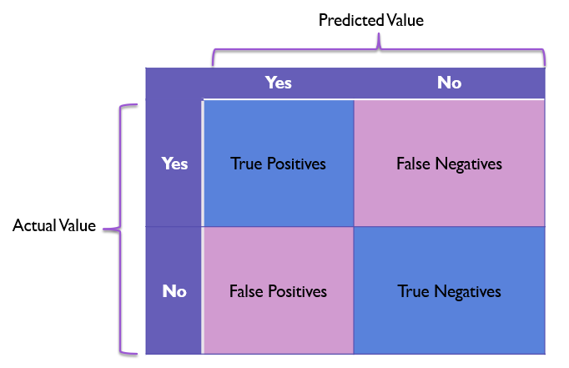

Slide 7
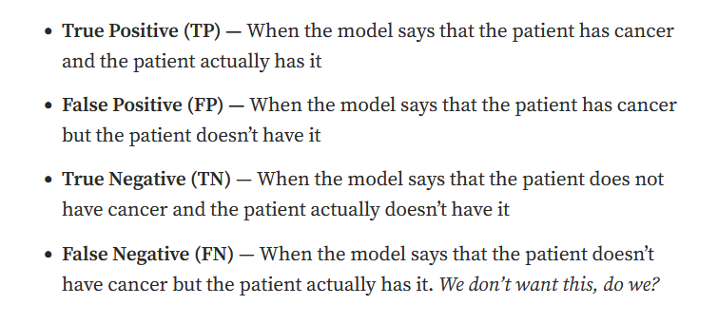

Slide 8
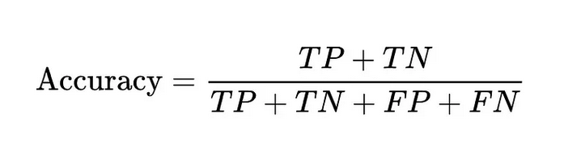
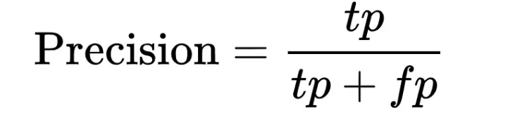
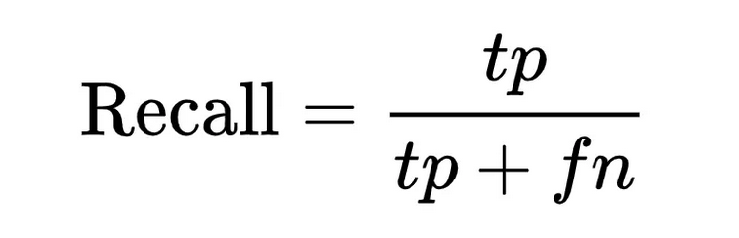
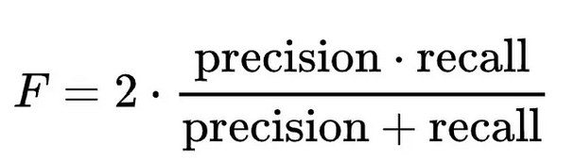
Classification metrics
Classification metrics are a set of evaluation metrics used to assess the performance of a classification model.
Accuracy: The proportion of correct predictions made by the model over all predictions.
Precision: The proportion of true positive predictions out of all positive predictions. It measures the model's ability to correctly identify positive instances.
Recall: The proportion of true positive predictions out of all actual positive instances. It measures the model's ability to correctly identify all positive instances.
F1-score: The harmonic mean of precision and recall. It provides a balance between precision and recall.
Area Under the ROC Curve (AUC-ROC): A metric that measures the model's ability to distinguish between positive and negative classes across all possible thresholds.
Notes:
Recall: actual positive class in the dataset had
Precision: what our ml model predicted positive class

Slide 9
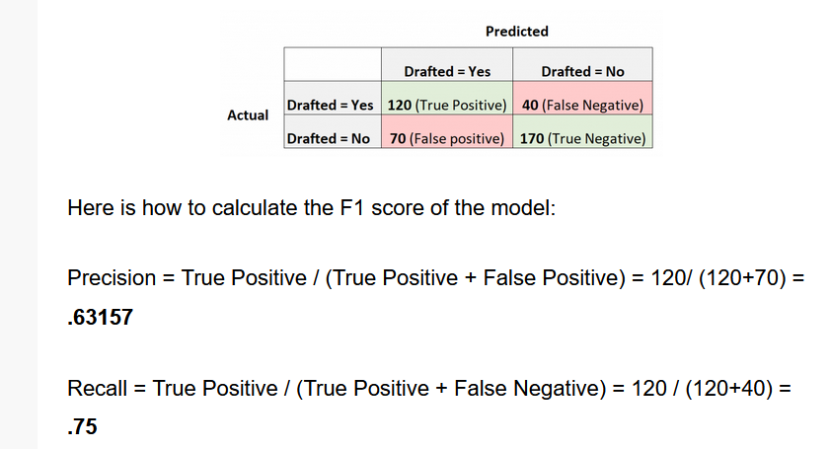

Example

Slide 10
Example
We have a test dataset of 10 records with expected outcomes and a set of predictions from our classification algorithm.
correct predictions
men classified as men: 3
women classified as women: 4
incorrect predictions
men classified as women: 2
woman classified as men: 1
2-class confusion matrix:
men women
men TP=3 FP=1
women FN=2 TN=4
Accuracy, precision, recall, F1-score?
Actual Predicted
man, woman
man, man
woman, woman
man, man
woman, man
woman, woman
woman, woman
man, man
man, woman
woman, woman

Slide 11
Exercise
Suppose we have a binary classification problem, where the task is to predict whether a patient has a certain medical condition or not based on some medical test results. The true labels are given as follows:
True Labels: [1, 0, 1, 1, 0, 1, 0, 0, 1, 1]
Suppose a classification model is trained on this data, and it makes the following predictions:
Predicted Labels: [1, 1, 1, 0, 0, 1, 0, 0, 1, 1]
Find accuracy, precision, recall, and F1-score
Notes:
TP = 5 (indices 0, 2, 5, 8,9) FP = 1 (index 1) TN = 3 (indices 4, 6, 7) FN = 1 (index 3)
Accuracy = (5 + 3) / (5 + 1 + 3 + 1) = 0.8 Precision = 5 / (5 + 1) = 0.8333
Recall = 5 / (5 + 1) = 0.8333 F1-score = 2 * (0.8333 * 0.8333) / (0.8333 + 0.8333) = 0.8333

Slide 12
Exercise
Find accuracy, precision, recall, and F1-score for the dataset
expected = [1, 1, 0, 1, 0, 0, 1, 0, 0, 0]
predicted = [1, 0, 0, 1, 0, 0, 1, 1, 1, 0]
Notes:
0 1
…………..
0.. 4 1
1 ..2 3

Slide 13
Where and when to accuracy?
Accuracy is a good measure when the target variable classes in the data are nearly balanced.
Ex: 60% classes in our fruits images data are apple and 40% are oranges.
Accuracy should NEVER be used as a measure when the target variable classes in the data are a majority of one class.
Ex: In a cancer detection dataset with 100 people, only 5 people has cancer.
Recall gives us information about a classifier’s performance with respect to false negatives (how many did we miss)
Precision gives us information about its performance with respect to false positives(how many did we caught)

